Slide 1
INGESTRE HALL RESIDENTIAL ARTS CENTRE
15 – 17 January 2025

Slide 2
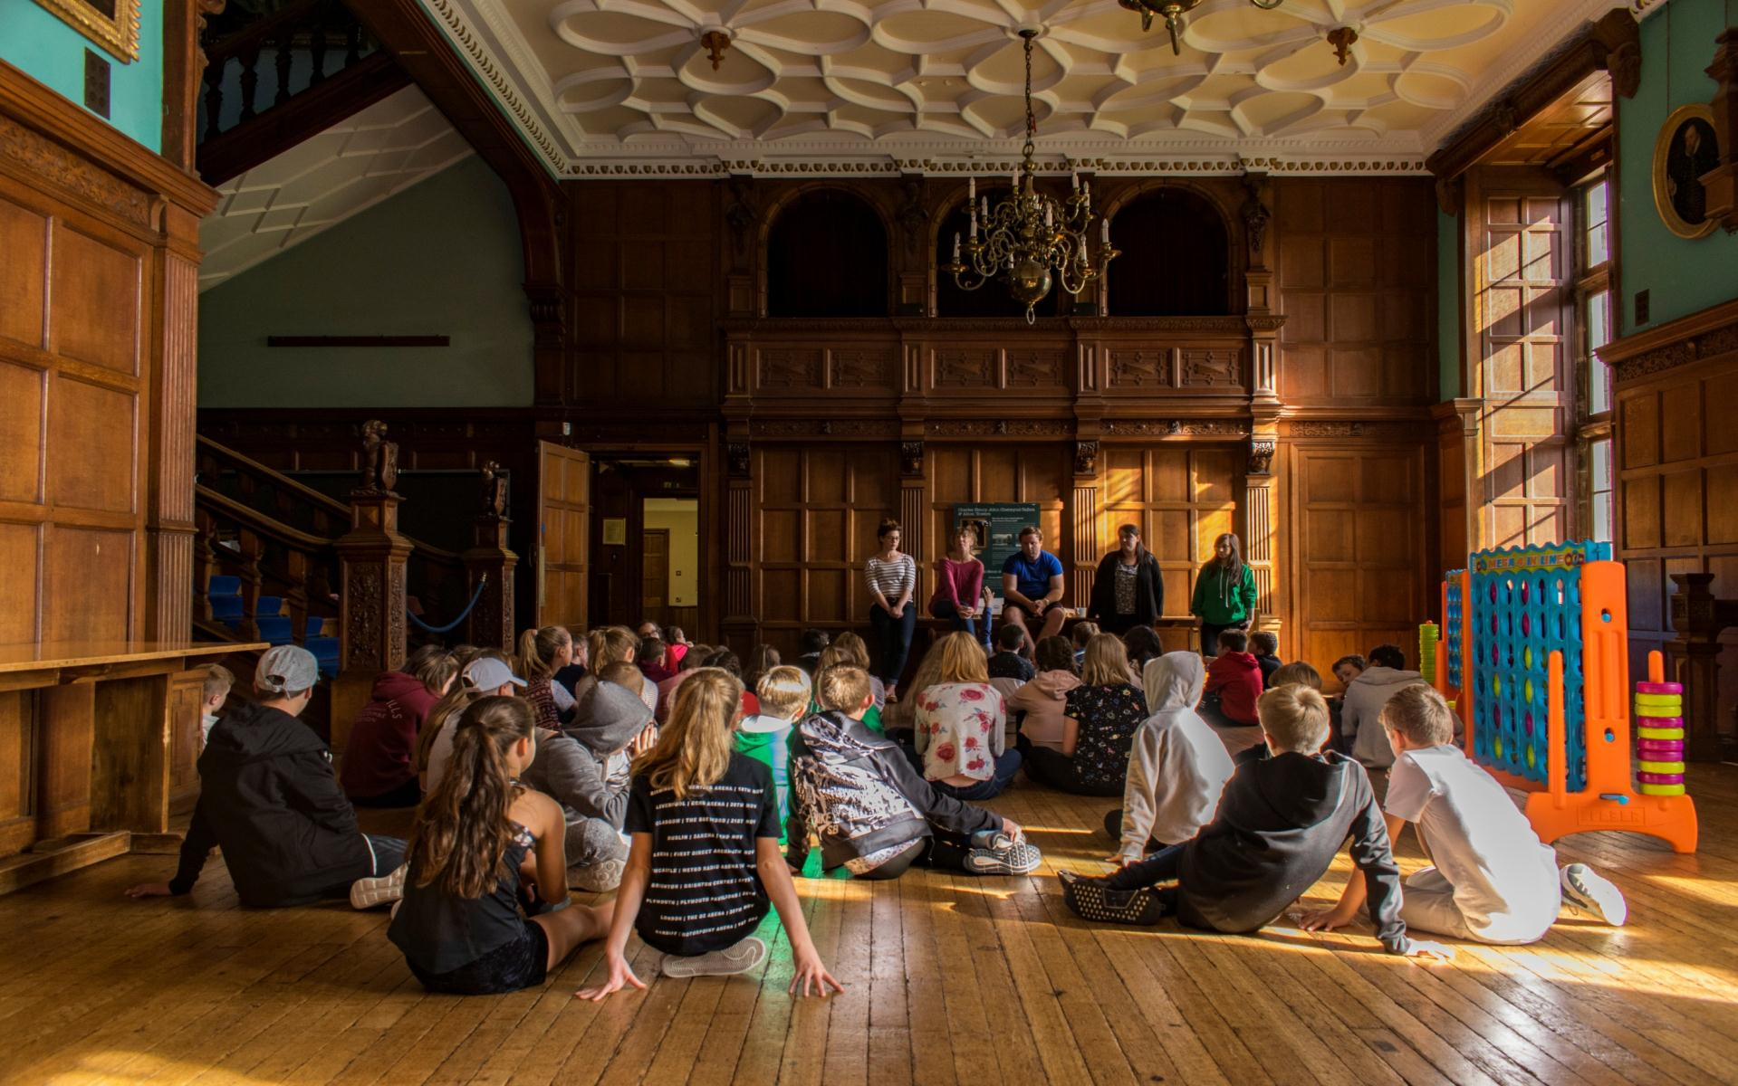
AGENDA
Ingestre Hall
Activities and learning
Sleeping & Eating & Medication
Timetable
Kit List
Q & A

Slide 3
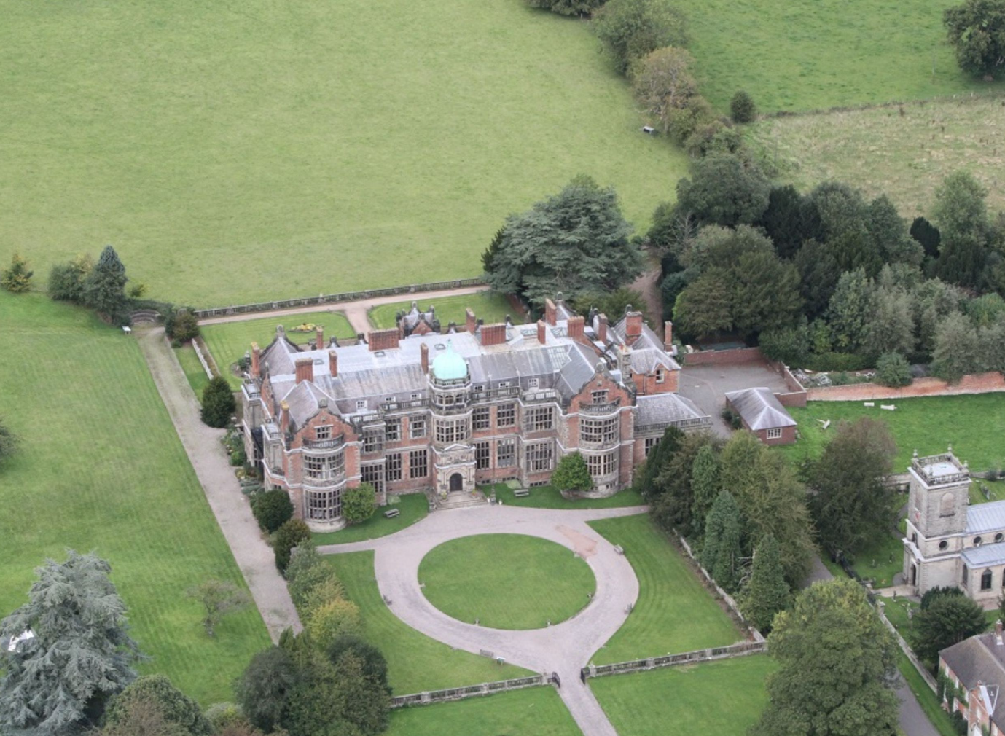
INGESTRE HALL
Ingestre Hall is home to the UKs only dedicated residential arts centre. We specialise in residential stays and creative learning adventures for children and young people from Y3 to university and have been welcoming young people to the centre for over 60 years.
Location
A 400-year-old Jacobean mansion creating a dramatic backdrop for creative & expressive arts.
Outside
27 acres of landscaped gardens. Plenty of safe space to play and explore.
Inside
Professionally equipped studios,
including recording studio, live performance space and art suites.

Slide 4
WHY GO TO INGESTRE HALL?
Develop independence & critical thinking skills
Try new things
and stick at them
Boost cohesion and sense of belonging
Professionally equipped studios
All inclusive –
no hidden extras
School & centre staff work as one team to provide the best experience.
A warm welcome awaits – the centre soon becomes a home away from home.

Slide 5
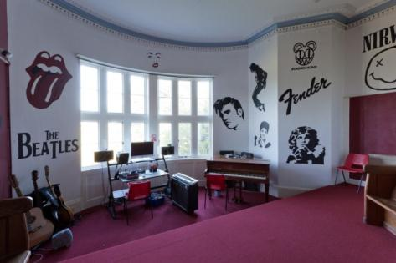
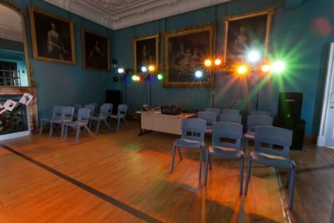
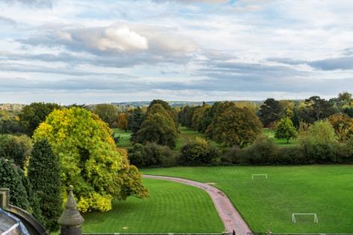
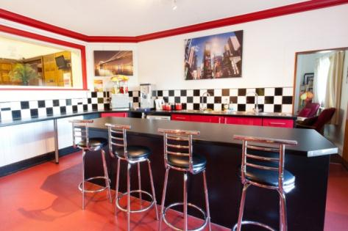
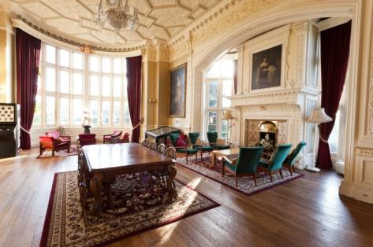
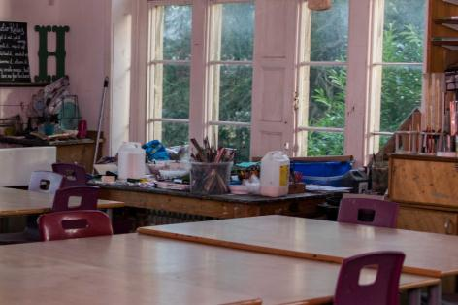
INGESTRE HALL

Slide 7
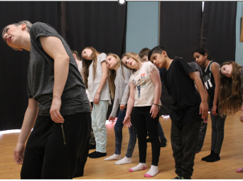
ACTIVITIES
The activities at Ingestre are all creative and expressive arts. There's no skill level or experience needed to take part because the activities are all about creating an original performance or piece of artwork, and the children use skills and techniques that aren't always available in school.
Your child has chosen one of these artforms to explore techniques and create something wonderful:
Drama
Art
Dance
Music
Within each group there will be a mix of children from across the 3 schools.
Creativity takes courage…..
…. but it’s a huge amount of fun!

Slide 8
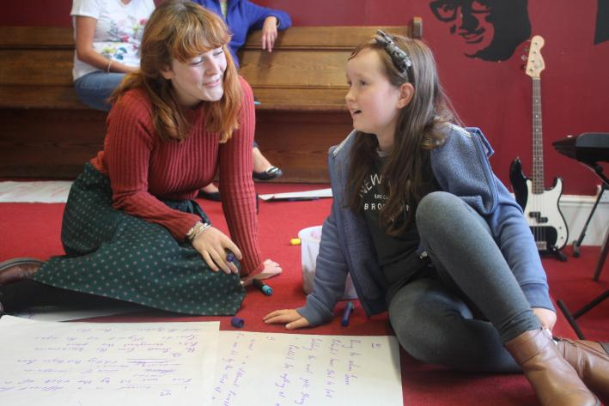
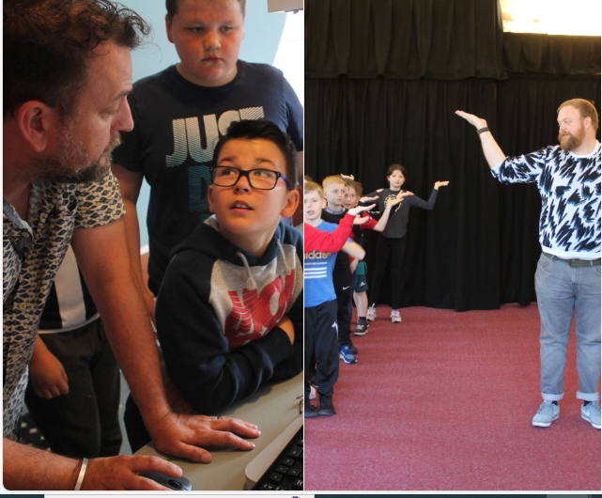
LEARNING
An overnight stay achieves different outcomes from a day of activities. In many cases, the biggest challenge for young people is not the activities that take place; it's being away from home - often for the first time - and sharing experiences with people that they don't always know very well.
To help this, the children are welcomed off the bus by the staff team that stay with them from start to finish so that relationships have time to develop. They are learning professionals that have fantastic technical skill and qualifications, but it's their soft skills that set them apart. They can help every young person to achieve more than they ever expected.
We have chosen the theme of the week to be:
Tailored Programmes
Every visit is unique. The centre work with school to shape an exciting, fun, and valuable visit to Ingestre.
Activity Group sizes are
15 children to 1 Ingestre tutor supported by school staff.
RESPECT

Slide 9
THE EVIDENCE
“LEARNING AWAY” – BRILLIANT RESIDENTIALS
Learning Away conducted independent research over 5 years. Their findings show how a residential experience can:
Improve students’ engagement with learning
Support students’ achievement
Improve resilience, self-confidence & wellbeing
Smooth transition
www.learningaway.org.uk

Slide 10
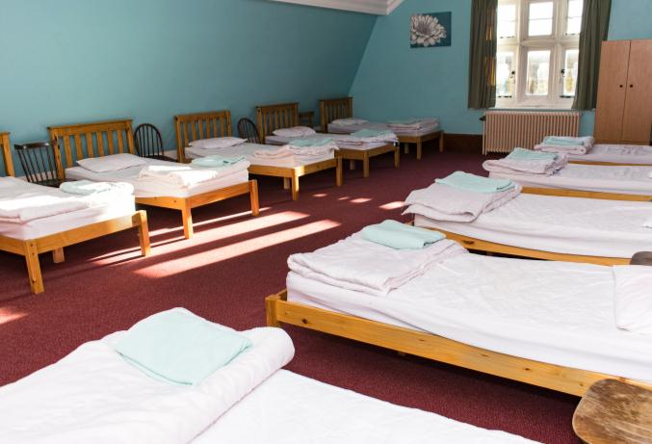
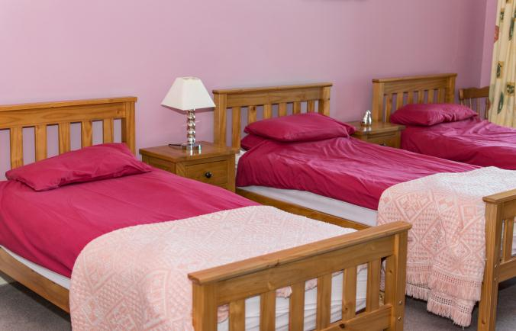
BEDROOMS
There are 90 single beds in comfortable dormitories. All Bedding is provided.
Rooms sleep between 4 and 11 pupils
We will stay in gender & school groups. Children have chosen who they will share a room with. ☺
Showers and toilet facilities are either en-suite or nearby on the same corridor.
Teacher rooms are on the same corridor and there is 24-hour on-site support from centre staff.
90 single beds
Dorms of 4 to 11

Slide 11
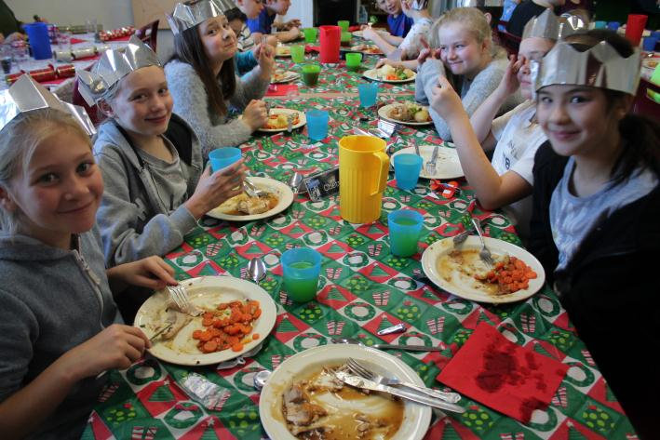
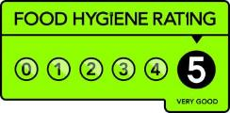
FOOD GLORIOUS FOOD
Each evening the children come together in our dining room for a home-cooked meal.
All dietary requirements are catered for.
Fruit is freely available.
 | Wednesday | Thursday |  | Friday
Breakfast | ----------------- | Cereals Toast with accompaniments
Lunch | Children bring own packed lunch in throw away packaging | Tomato Pasta Bake | Wraps with a choice of filling
 |  | Salad Bar freely available
Dinner | Roast Chicken With Potatoes & Vegetables | Pasta Bolognese with Garlic Bread Salad Bar | ---------------
 | Dessert: Flapjack, Chocolate Chip Cookies, Sponge Pudding

Slide 12
FOOD GLORIOUS FOOD
During the day there are periods of time where the children may be able to have a snack ☺
Fruit is freely available.
Children must have a refillable water bottle – Clearly labelled with their full name.
YOU provide the snack that your child will eat during their stay.
Please ensure it nut free.
The snack must be in a resealable bag and labelled with your child’s full name.
Children will hand in their snack to the teachers on the morning of the visit.

Slide 13
Medication
Children will not be allowed to attend the visit without a completed medical form.
This will run very similar to how it would in school
1: Complete the medical form with all medicine taken regularly and medicine that is taken as a reaction.
2: Label all medicine itself, put in a resealable bag which is also labelled, and hand in to the teacher on the morning of the trip.
3: During the trip the medicine will kept in a staff only area and administered as directed on the medical form.
4: Self-administered medication, that is used ‘on the go’, such as inhalers or emergency medication such as epi-pens, will remain with the child during all activities.
5: All staff members will be made aware of medical conditions.
All medication must be clearly labelled with your child’s Full Name.

Slide 14
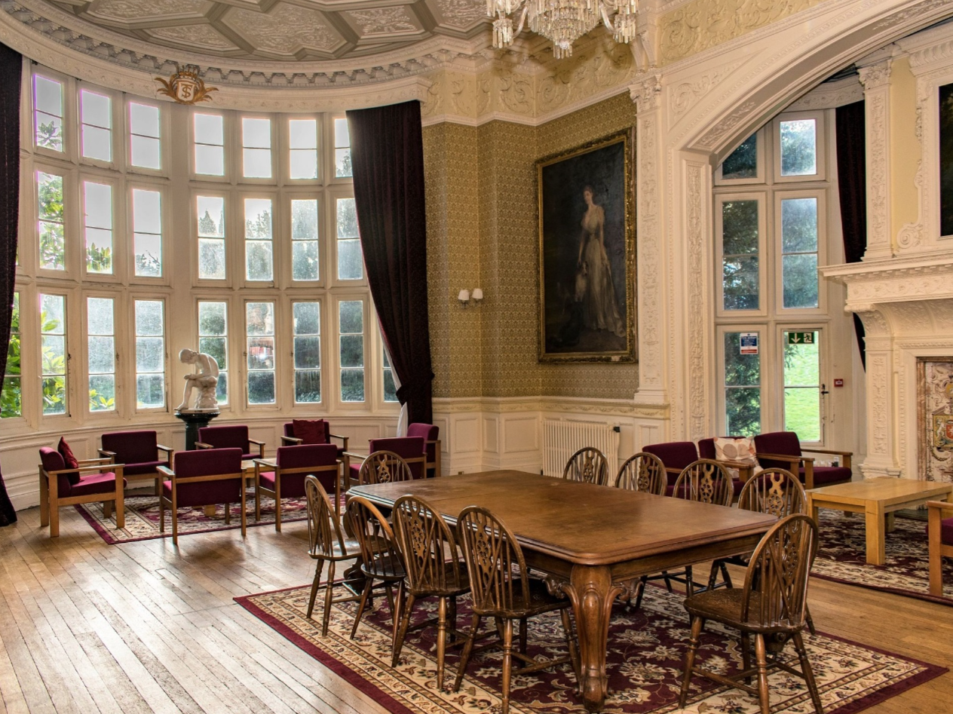
What does the week look like?
 | Wednesday | Thursday | Friday
Morning | 11:00: Arrival 11:30: Dormitories and Tour 12:20: Break 12:30: Lunch | 08.30: Breakfast 09:30: Workshop 10.30: Break 11:00: Workshop 12.20: Break 12:30: Lunch | 08.30: Breakfast (strip beds, luggage downstairs) 09:30: Workshop 10.30: Break 11:00: Sharing of Work 12.20: Break 12:30: Lunch
Afternoon | 14:00: Workshop 15:00: Break 15:30: Workshop 17:00: Break | 13:30: Workshop 15:00: Break 15:30: Workshop 16:30: Break | 13:30: Farewell and Departure
Evening | 17.15: Dinner 18:30: Evening Activities including a Night Walk & Film Showing | 17.15: Dinner 18:30: Evening Activities Including a Disco
Children are allowed to bring non-electronic activities for the breaktimes.
For example; Top Trump cards, reading, writing & sketchbooks, Travel games with no small pieces.

Slide 15
Souvenirs
There is a selection of branded souvenirs the children can buy to remember their trip.
Children can bring up to £5 in coins in an envelope – clearly labelled with full name
This will be given to staff the morning of the trip.
An idea of what can be bought:
Between £1 - £2
Pens ∙ keyrings ∙ rubbers ∙ rulers ∙ lanyard ∙ compass ∙ snap band ∙
soft ball
Over £3
Tote Bag ∙ Drinks bottle ∙
Cuddly bear ∙ Torch
This list is not exhaustive, and items will vary.

Slide 16
What to bring: This list can be found on the parent information leaflet
Outdoor shoes (wellies or walking boots)
Hat, Scarf, gloves
Refillable water Bottle
Plastic bag for dirty clothing
Torch
Optional; £5 in coins
Toiletries (toothbrush, toothpaste, shower gel, Deodorant - NOT aerosol spray
Towel(s)
Nightwear
Warm Coat
Indoor shoes/Trainers
Slippers
Loose comfy clothing that can be layered.
Art – Overall or old shirt to cover clothing
Dance – Dance appropriate clothing
NO MOBILE PHONES/SMART WATCHES
NO INTERNET DEVICES
NO ELECTRONIC DEVICES

Slide 17
Wednesday 15 January 2025
1
Arrive at school in non-uniform at normal time. With your bag that you can carry!
2
Children head straight to the KS2 hall with parent through the office.
3
Say goodbyes as normal, with extra love.
4
Give in snack, medication and souvenir money to the teachers
5
Coach will arrive at around 10am.
6
Off we go…..

Slide 18
Days of Trip (Parents/Carers)
1
Use the MyEd App
2
Look at the website.
3
We will send you a brief update through MyEd
4
We will load photographs to the website
(those with permission only)
5
You communicate with school as usual

Slide 19
Friday 17 January 2025
1
Leave the Ingestre Hall at approximately 1:30pm
2
School will MyEd you that we have left.
3
Arrive at school approximately 2:00pm
4
Collect children and siblings at 2pm.
Enjoy the weekend.

Slide 20
Questions?

