Slide 1

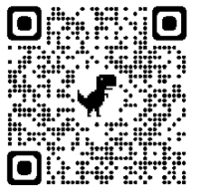
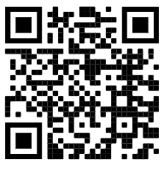
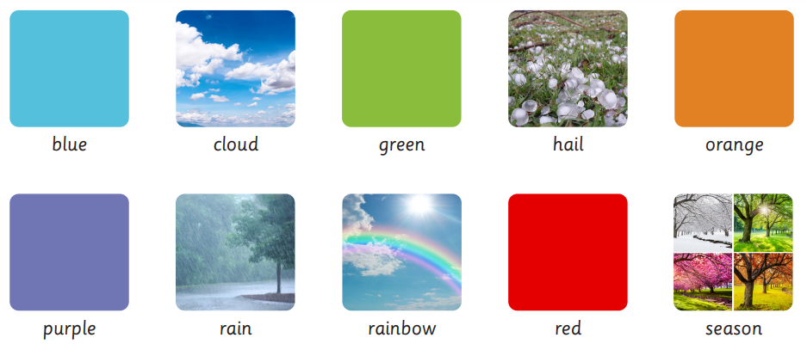
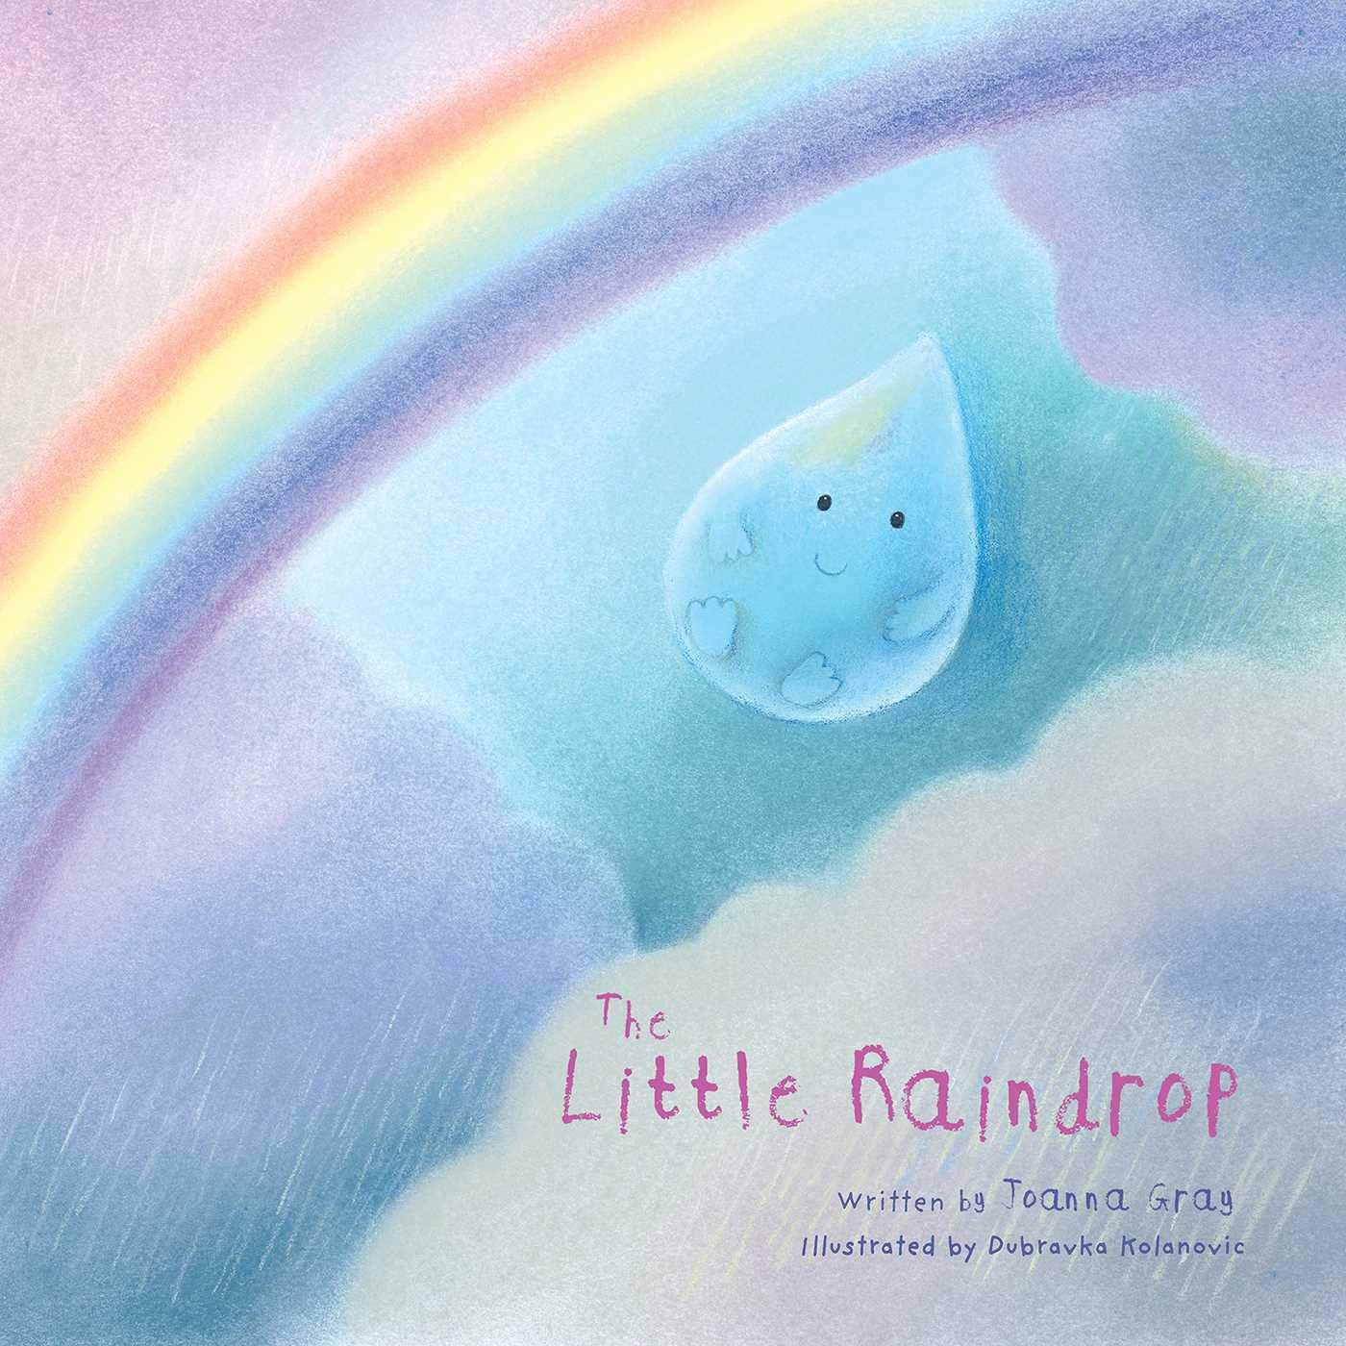
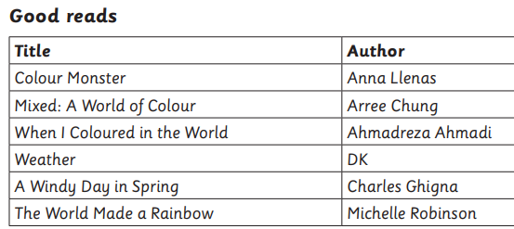
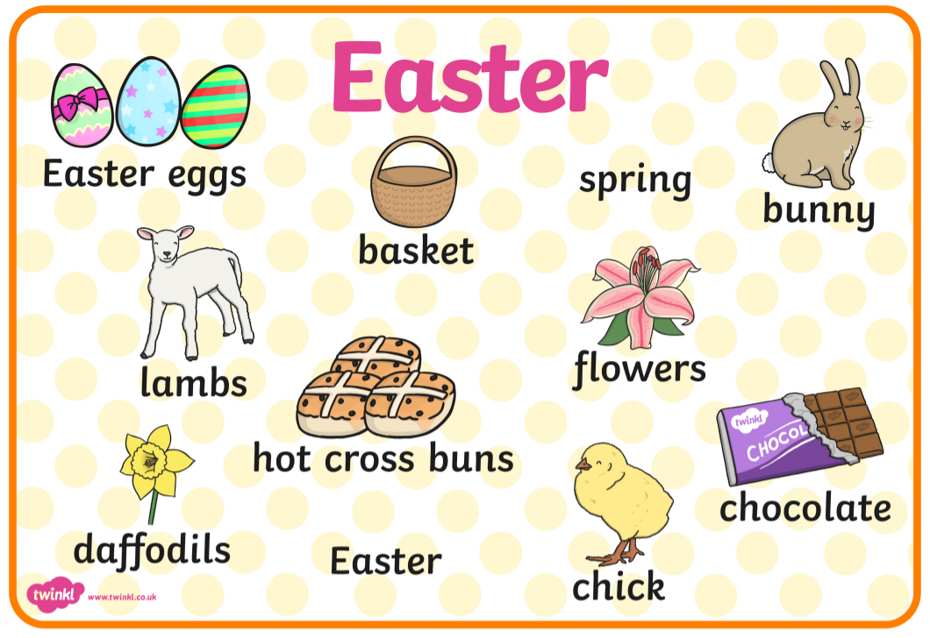
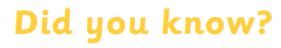
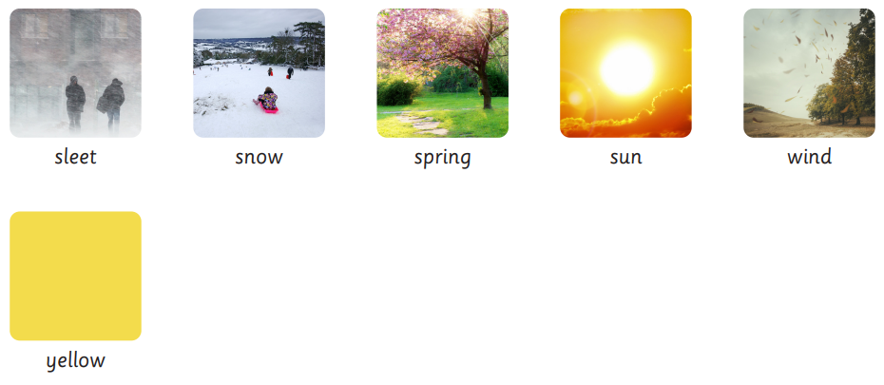
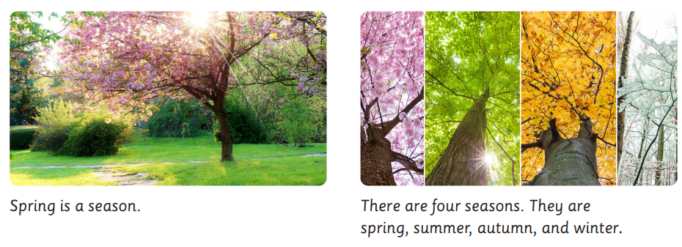

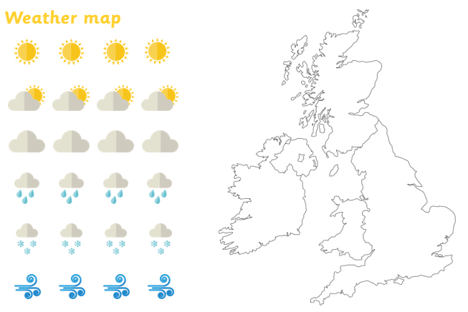
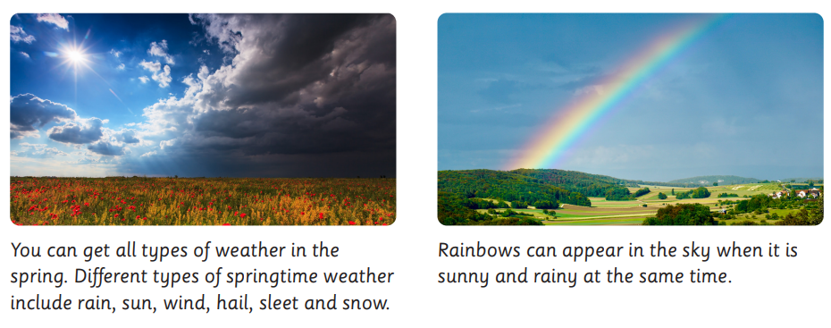

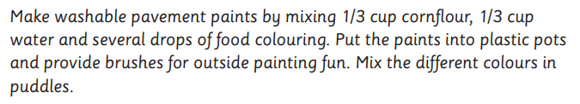
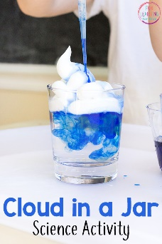
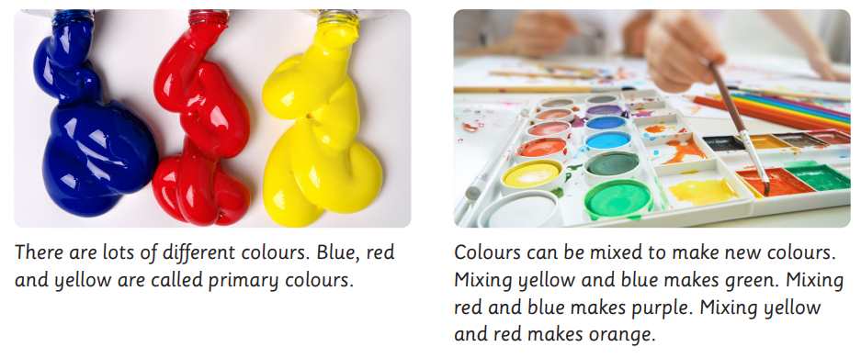
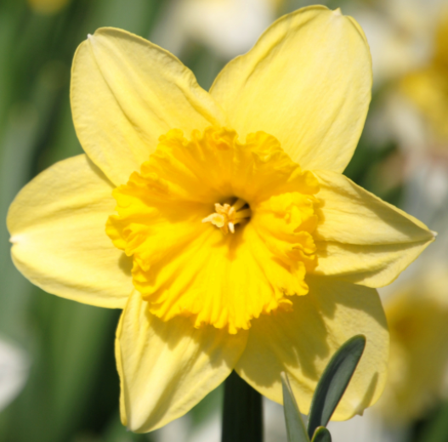
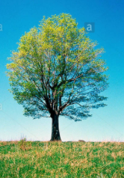
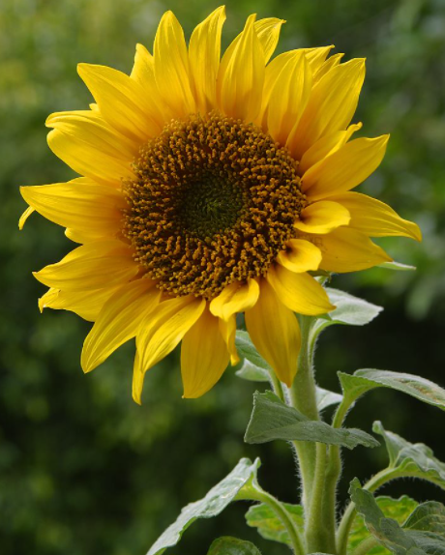
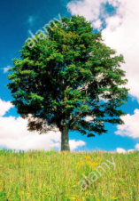
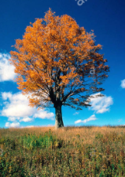
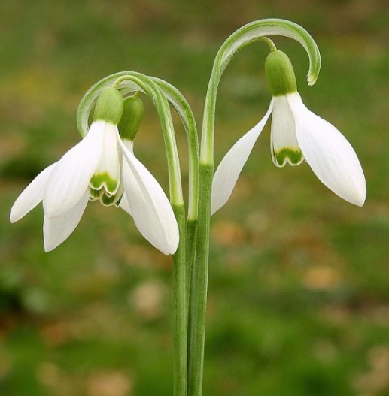
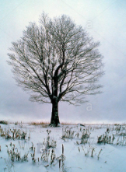
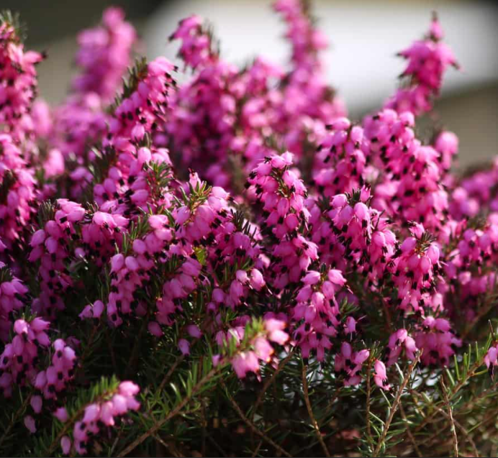
Early Years: Knowledge Organiser: Spring 2: Puddles and Rainbows
We’re going on an egg hunt
Possible learning experiences:
Learning about Easter / signs of spring
Outdoor numbered egg hunt
Designing repeating patterned egg designs.
Design a parachute to save an egg.
Key Books:
Key Vocabulary:
Possible Learning opportunities:
Comparing the weather during the four different seasons.
Becoming a weather reporter.
Sequencing the days of the week.
Using vocabulary yesterday, today, tomorrow.
Naming weather symbols.
Investigating which materials are waterproof.
Did you know?
- Rain clouds are large collections of tiny water droplets. When the water droplets get too heavy, they fall to the earth as rain.
- Natural phenomena include weather, shadows, rainbows, clouds, flooding and waves.
Did you know?
Rainbows are formed when light shines through water, like when the sun shines through the rain. This light is bent and reflected, like a reflection in a mirror, and this causes all of the amazing colours that you see. ... Rainbows are made up of all seven colours that come from light.
We will talk about how rain clouds are formed and complete a science activity ‘Cloud in a Jar’.
Spring | Summer | Autumn | Winter

Slide 2
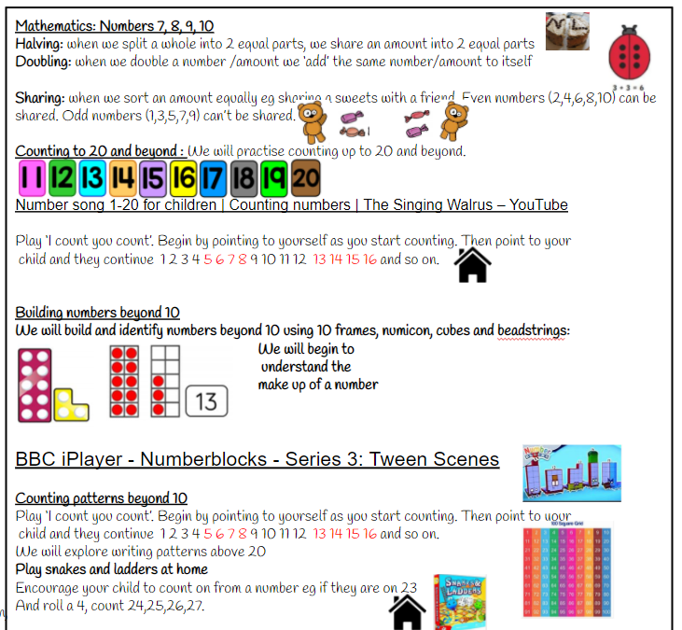
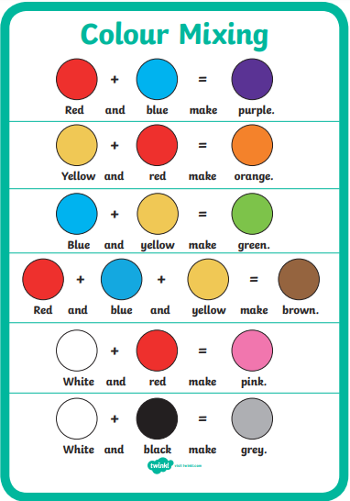
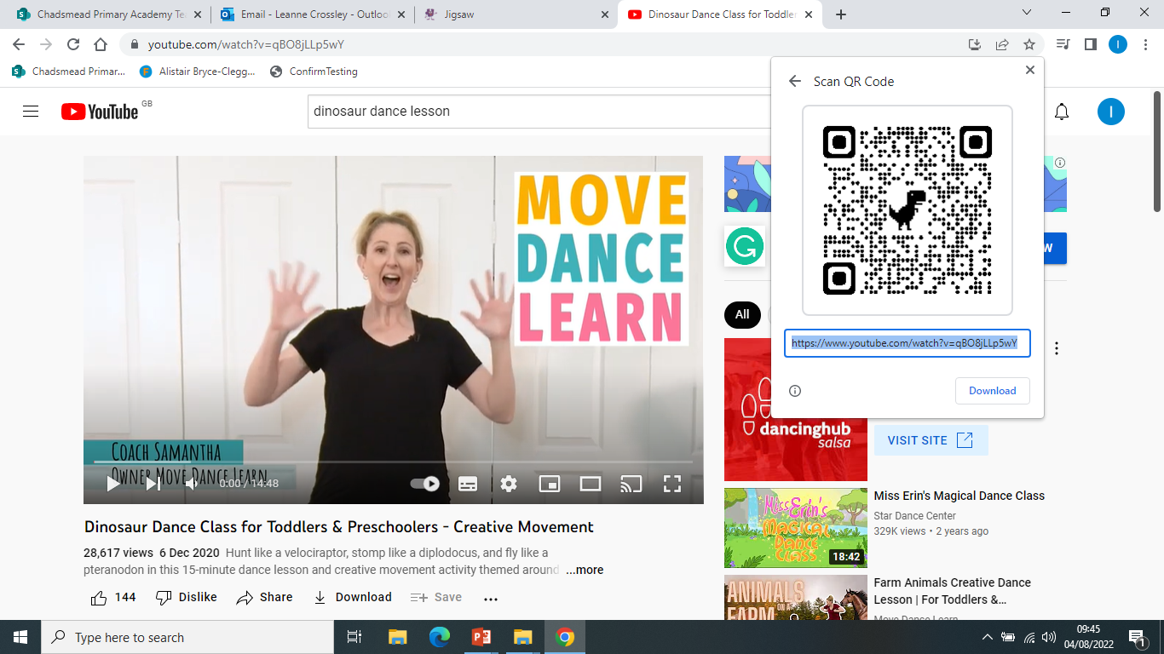
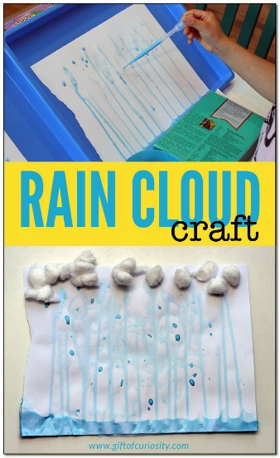
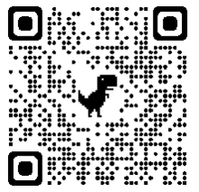
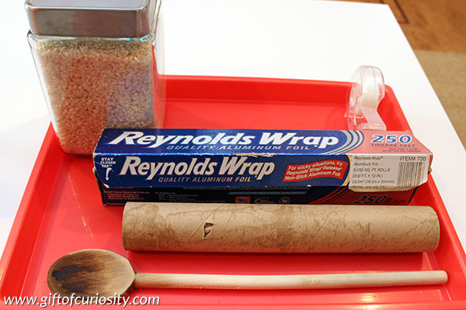
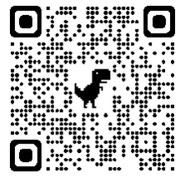
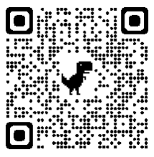
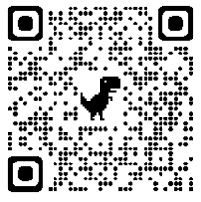
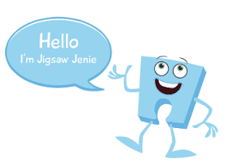
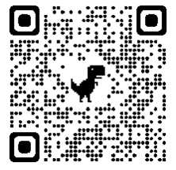
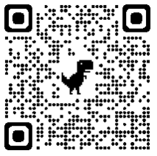
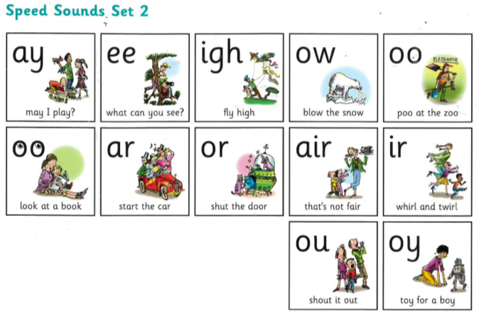
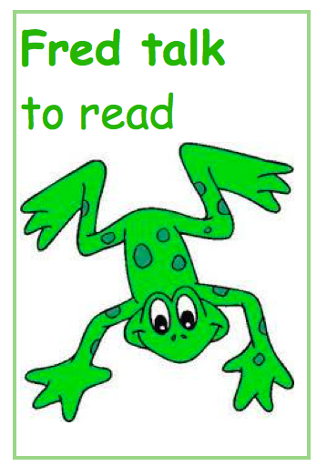
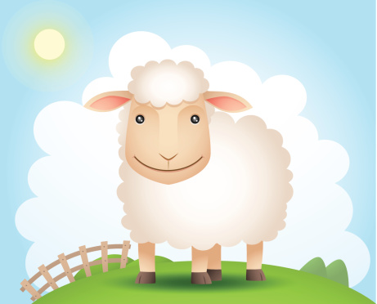

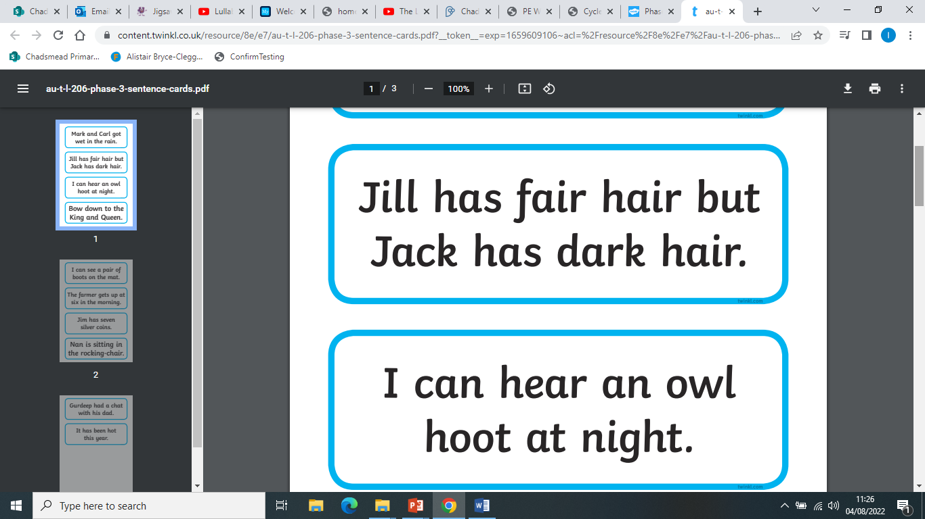
Physical Development: Gross and Fine motor Skill
Handwriting - Develop the foundations of a handwriting style which is fast, accurate and efficient.
Physical Development- PE – Dance linked to
Dinosaurs
Expressive Arts and
Design:
Activity 1- Painting a
rainbow by mixing colours.
Activity 2- Rain cloud- We will explore creating a rain cloud using watered-down ready-mixed paint in shades of blue and grey, cotton wool and straws. We will blow the paint with the straws to make it look like rain.
Activity 3- Creating a
Rain stick.
Colours of the Rainbow song…
Scan the QR codes and join in with the songs.
Join in with the number bond song to 10.
Jigsaw (PSED): Puzzle 4- Healthy Me
Piece 4- I know how to help myself to go to sleep and understand why sleep is good for me.
Piece 5- I can wash my hands thoroughly and understand why it is important especially before I eat and after I go to the toilet.
Piece 6- I know what a stranger is and how to stay safe if a stranger approaches me.
Oak National Academy- Doubling and Sharing
Literacy: Reading
Literacy: Writing
Begin to orally compose and write a simple sentence.
Continue to learn Set
2 sounds
Spell to write VC, CVC and CVCC words independently using Set 1 and Set 2 graphemes.
Spell some irregular common (red) words e.g., the, to, no, go, of etc independently.
Oral Segmenting - this is when you split a word up into its individual sounds (c-a-t). We call this ‘Fred talk’.
Orally compose (say) a phrase /sentence.
Tap, clap, stomp.
Count how many words.
Say first word / Fred talk the word / write the word.
Oral blending - this is when you blend the sounds together to say the word (cat). We use a blending arm motion from left to right to help blend the sounds together.
Holds a pencil effectively to form recognisable letters. Know how to form clear ascenders and descenders.
Using our phonics to help us read:
Blend and segment known sounds for reading
Read simple phrases and sentences made up of words with known letter–sound correspondences and, where necessary, a few exception words.
The sheep is on the green hill.
ascenders
b d h k l t
Can you write a sentence about your favourite colour? E.G. My favourite colour is … because …
j p q y
Digraph: two letters that make one sound- ay, ee, ow, oo, ar, or, ir ou, oy
descenders
f
Trigraph: three letters that make one sound: igh, air
Can you practise ascenders and descenders?

