Slide 1

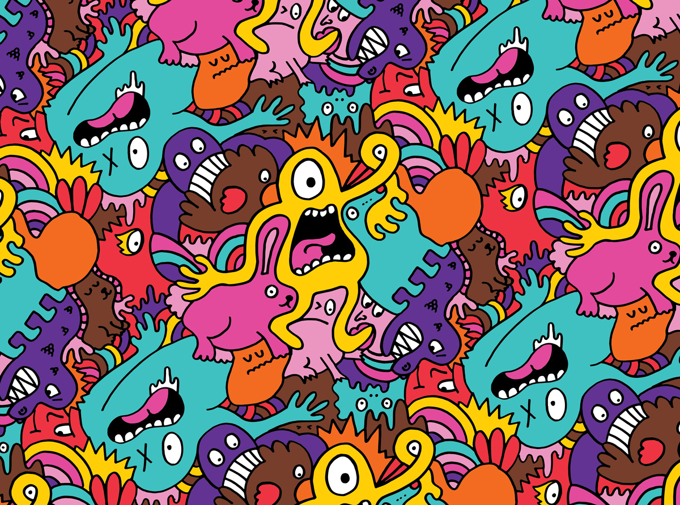

Puberty
Body Changes
Year 6
Presented by Michelle Wilmot CNN
School Nurse Team

Slide 2


What Is Puberty ?
When your body reaches a certain age, your brain releases special hormones that starts the changes of puberty
Each person is a little different, so everyone starts and goes through puberty on his or her body's own timing.
It is a period of time when your body changes from a child’s to an adult. Also called adolescence
Varies but mostly between the ages of 10 and 14 but may not end till late teens

Slide 3

Girls
Mood swing oily hair – greasy hair Body sweats more
Hair grows under the arms oily skin - spots
Hips grow wider and
waist goes in Sudden growth spurt- hands, feet,
bones, face and weight gain
Hair grows on the vulva
Pubic hair
Menstruation – period starts
Discharge from vagina
Sticky white Eggs – ova start to be released
Breast and nipples gradually grow larger

Slide 4
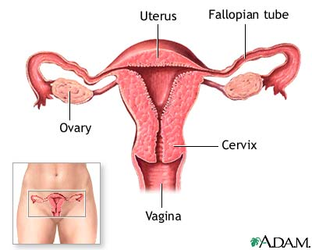
What’s on in the inside

Slide 5
The Menstrual Cycle
Brain sends message to ovaries – wake up!
Ovaries start to produce oestrogen and progesterone
Oestrogen tells the eggs which have been in the girls ovaries since birth to grow up – usually only 1 egg grows up each month
The lining passes out of the uterus through the vagina this is called menstruation / period
The uterus – womb prepares for the egg by making a soft lining
The soft lining of the uterus is not needed so breaks away
If the egg is not united with a sperm it breaks down and dissolves
    Only a few tablespoons of blood is lost – a period lasts about 3-8 days. Girls use sanitary products to protect their clothing – it’s a natural and healthy process
Notes:
Another thing that comes with puberty is acne, or pimples. Acne is triggered by puberty hormones. Pimples usually start around the beginning of puberty and can stick around during adolescence (the teen years). You may notice pimples on your face, your upper back, or your upper chest. It helps to keep your skin clean, and your doctor will be able to offer some suggestions for clearing up acne. The good news about acne is that it usually gets better or disappears by the end of adolescence.

Slide 6
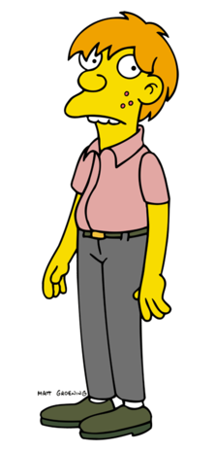
Boys
Hair grows around the penis – pubic hair
Testicles gradually grow larger and fuller
Penis gradually grows longer and thicker
Body sweats more
Hair grows under the arm
Skin becomes oily - spots
Scrotum turns a darker colour
Sperm begins to be produced
Ejaculations Wet dreams
Sudden growth spurt , arms, legs, hands, feet, face, weight gain
Chest hair
Larynx / voice box grows bigger causing the voice to become deeper
Shoulders and chest grow, muscles develop
Adams apple becomes noticeable
Facial hair grows
Notes:
A lot of teens notice that they have a new smell under their arms and elsewhere on their bodies when they enter puberty, and it's not a pretty one. That smell is body odor, and everyone gets it. As you enter puberty, the puberty hormones affect glands in your skin, and the glands make chemicals that smell bad. These chemicals put the scent in adolescent!
So what can you do to feel less stinky? Well, keeping clean is a good way to lessen the smell. You might want to take a shower every day, either in the morning before school, or the night before. Using deodorant (or deodorant with antiperspirant) every day can help keep body odor in check, too.

Slide 7
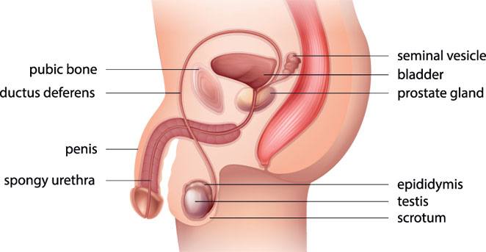
What’s on in the inside

Slide 8
New and changing feelings
Notes:
Guys and girls will also notice other body changes as they enter puberty, and they're all normal changes. Girls might see and feel a white, mucous-like discharge from the vagina. This doesn't mean anything is wrong — it is just another sign of your changing body and hormones.
Guys will start to get erections (when the penis fills with blood and becomes hard). Erections happen when guys fantasize and think about sexual things or sometimes for no reason at all. They may experience something called nocturnal emissions (or wet dreams), when the penis becomes erect while a guy is sleeping and he ejaculates. When a guy ejaculates, semen comes out of the penis — semen is a fluid that contains sperm. That's why they're called wet dreams — they happen when you're sleeping and your underwear or the bed might be a little wet when you wake up. Wet dreams become less frequent as guys progress through puberty, and they eventually stop. Guys will also notice that their voices may "crack" and eventually get deeper.

Slide 9
Taking care of your Body
DIET AND EXERCISE
Increase in hair growth
Rapid growth spurt
Some girls decide to remove hair that grows on their legs and under arms
Some boys decide to shave off their facial hair
Your body needs more “good foods” containing vitamins, minerals, protein and carbohydrates and less Junk food which is high in fat.
Regular exercise helps to strengthen growing bones and muscles
Increase in sweat production
Sweat more under arm, feet, all over - develop new kind of body odour. So will need to change clothes and wash more often
Skin and hair become oily – may get spots on face / back. Wash hair and face frequently, avoid greasy foods. See Dr if spots are very bad

